Slide 1
Context R-CNN: Long Term Temporal Context for Per-Camera Object Detection Sara Beery , Guanhang Wu, Vivek Rathod, Ronny Votel, JonathanHuang California Institute of Technology Google
deer
cat

Slide 2
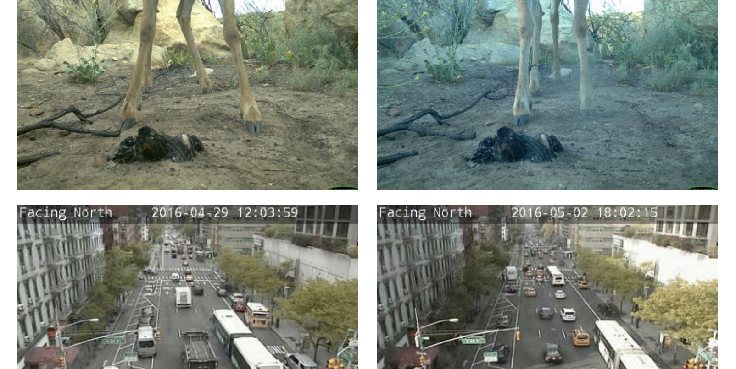
Static monitoring cameras
Notes:
Then, we crop out the region of interest...

Slide 3
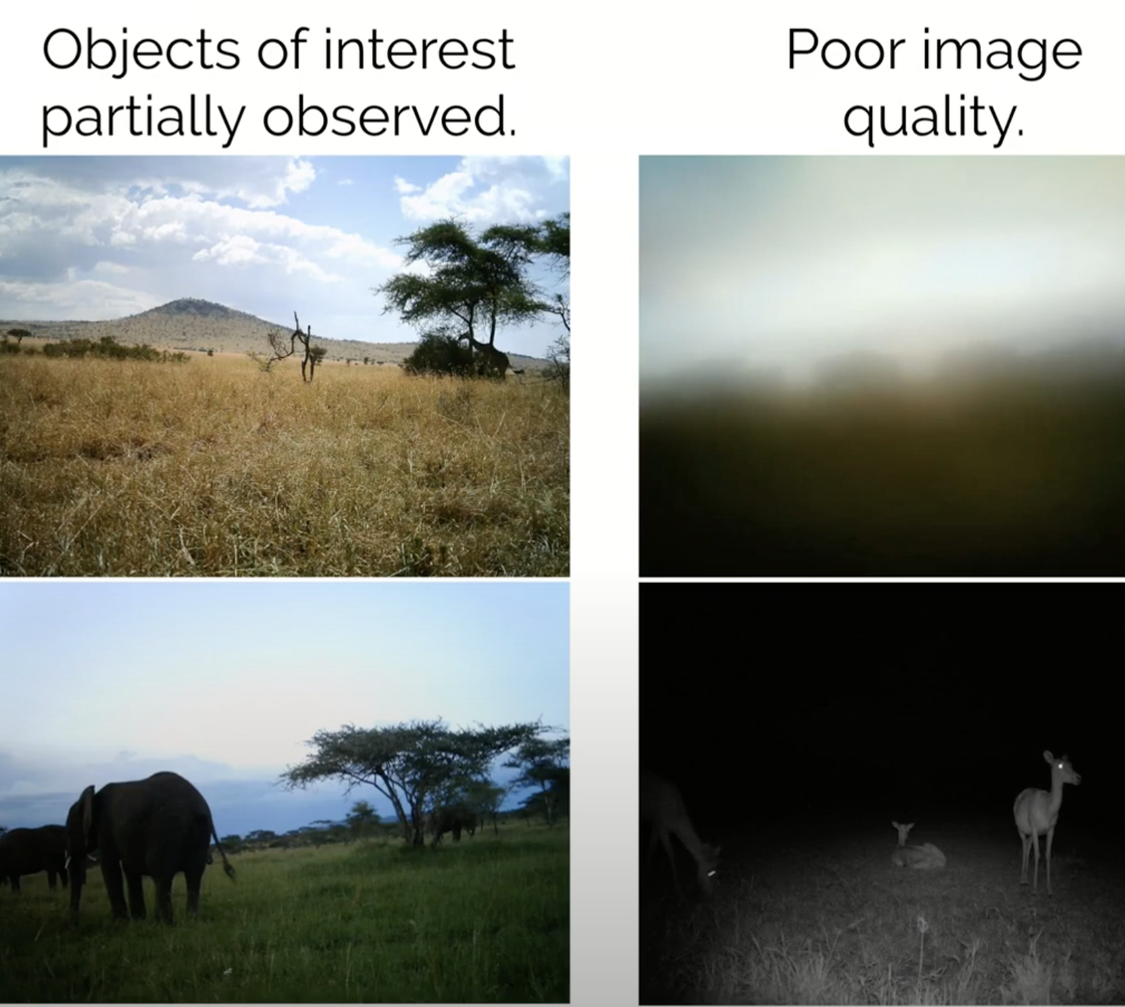
Static camera images

Slide 4
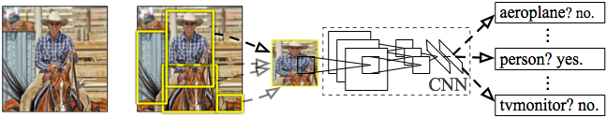
R-CNN: Regions with CNN features
Input image
Extract regions of interest
Compute CNN features
Classify region
Notes:
Here’s a schematic of the system that we came up with.
Compared to previous state-of-the-art methods, R-CNN is relatively simple and does not rely on an ensemble of classifiers.
Let’s see how it works at test time.

Slide 5
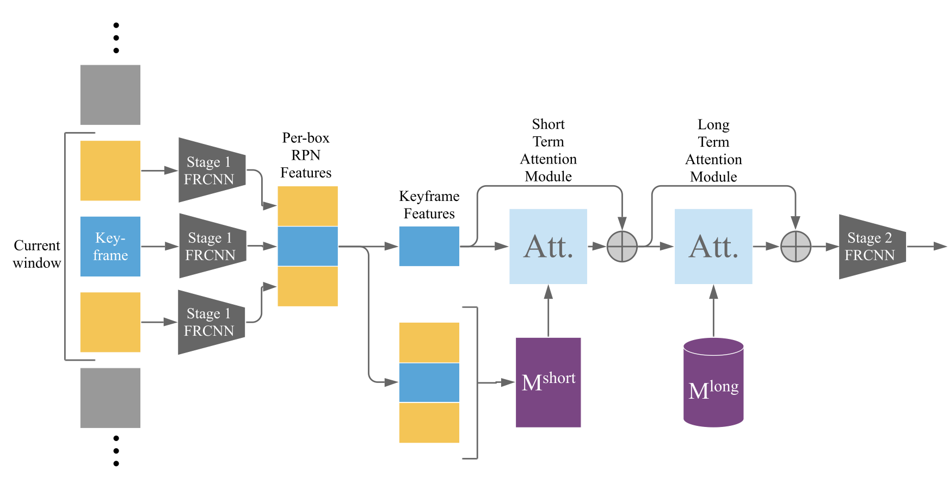
Context R-CNN Architecture

Slide 6
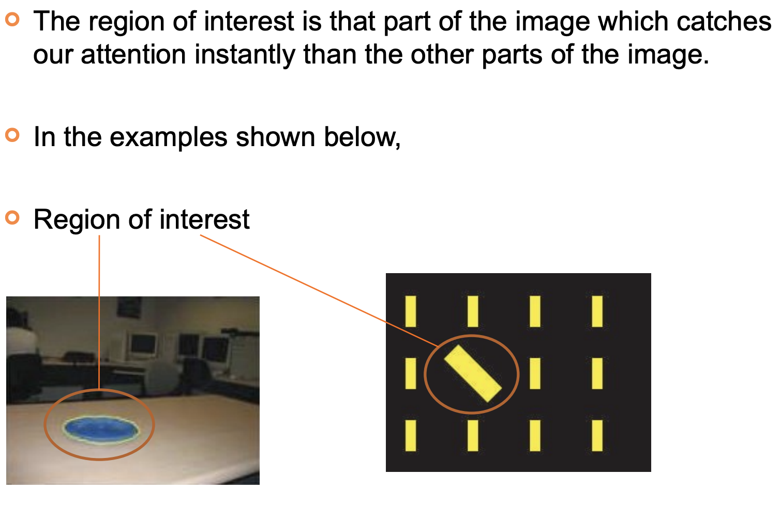
Stage-1

Slide 7
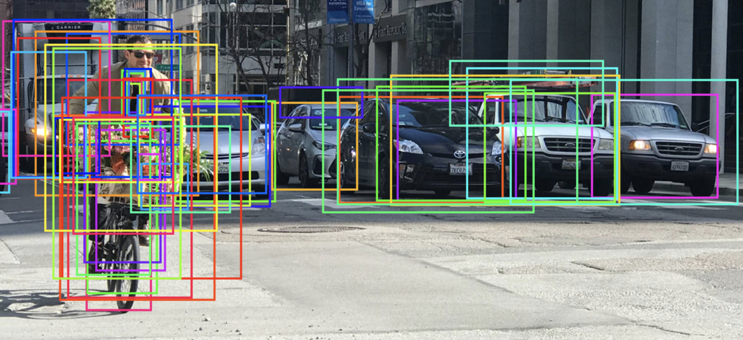
Stage-2
FRCNN classifies those region of interest vectors
Between two stages there are two attention modules with short and long term memory

Slide 8
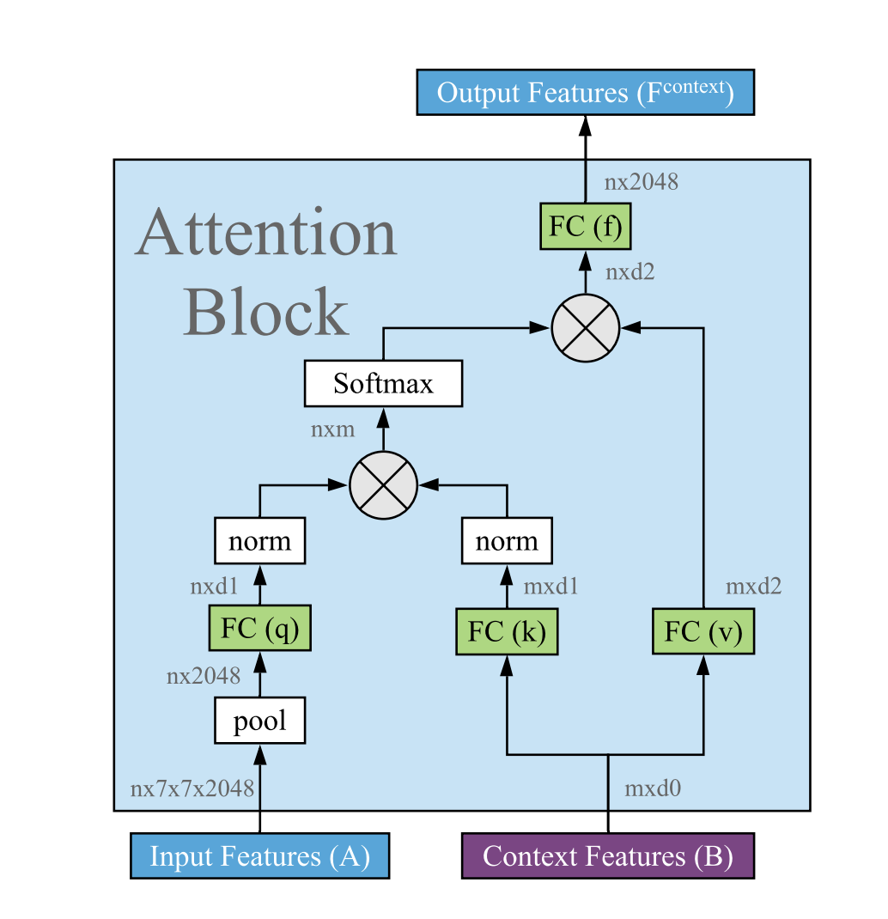
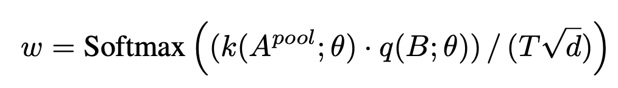
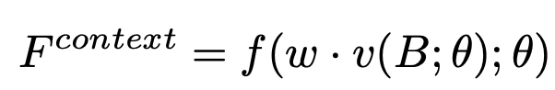
Attention Mechanism

Slide 9
Coco Pre-Trained Dataset
80 diverse categories
100K images
Heavy occlusions, many objects per image, large scale variations

Slide 10
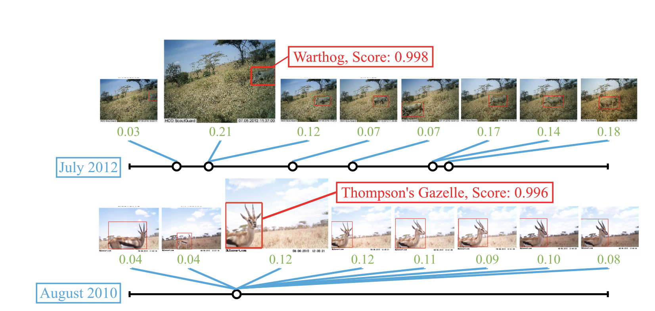
Visualizing attention

Slide 11
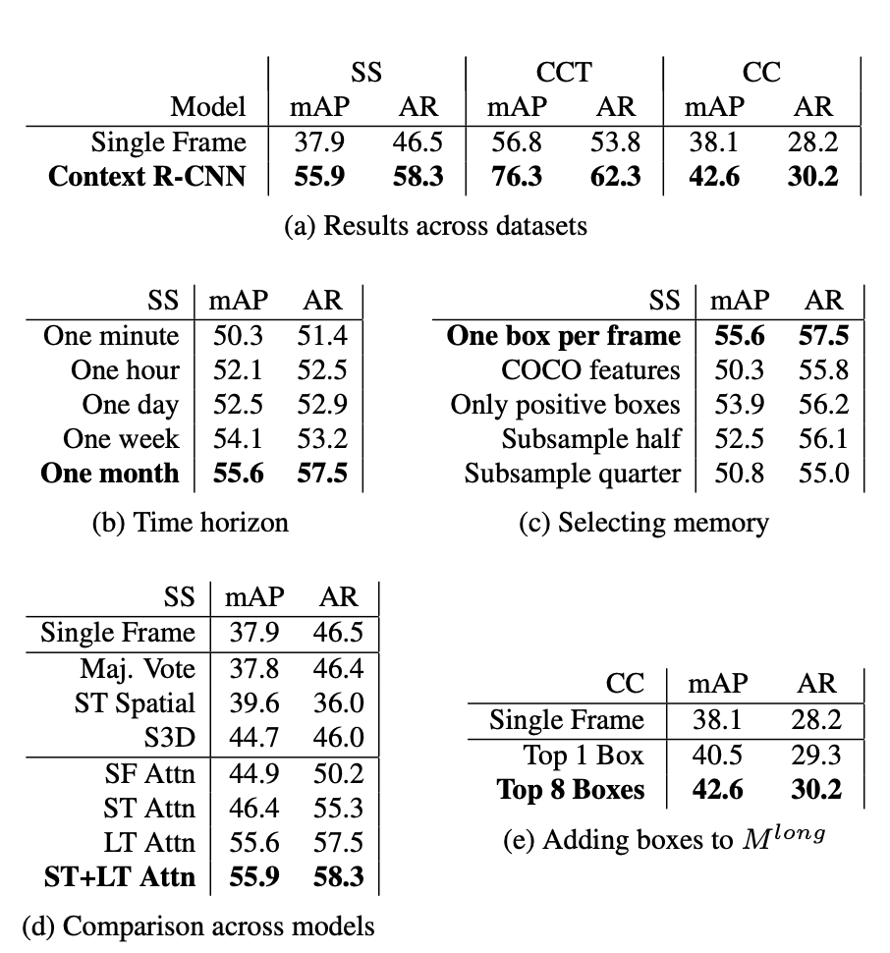
Results:

Slide 12
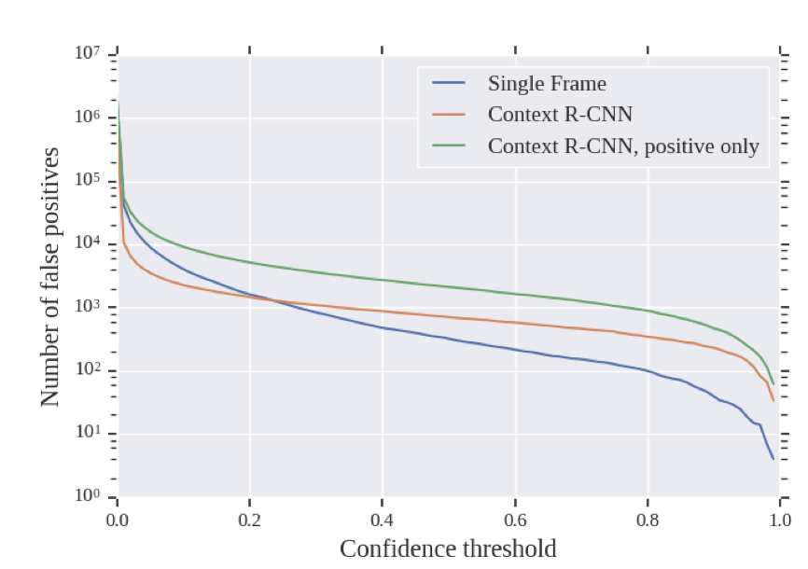
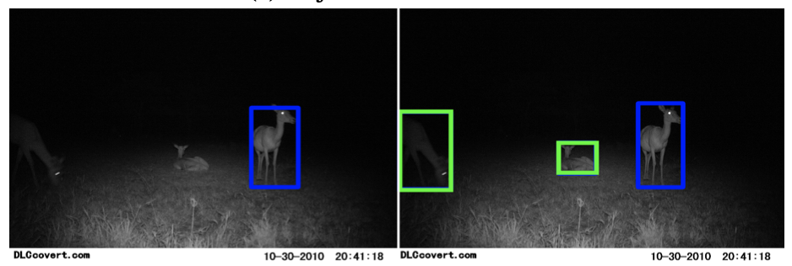
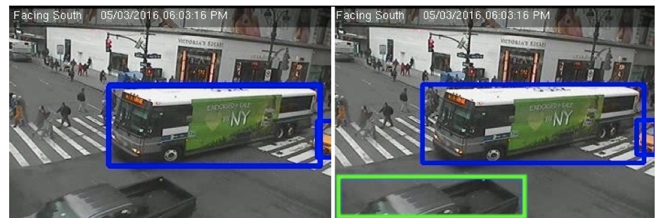
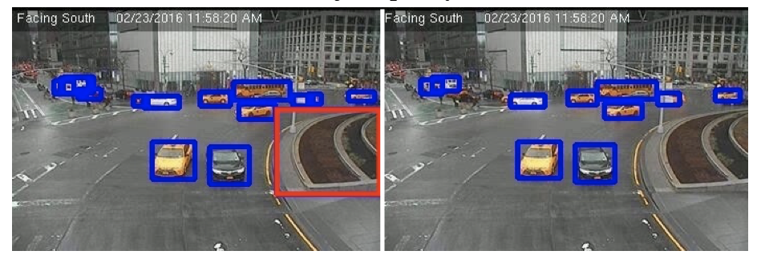

Slide 13
Conclusion:
This paper says that they’ve investigated the 100 highest confidence “false positives” from Context R-CNN, and found that in almost all of them (97/100), the model had correctly found and classified animals that were missed by human annotators.
Snapshot Serengeti dataset (which proved to be almost universally true detections that were missed by human annotators) the 3/100 images where Context R-CNN erroneously detected an animal were all of the same tree, highly confidently predicted to be a giraffe.
The new target detection architecture improves the target recognition effect in the new scene by extracting the context clues of each camera in the time dimension, without the need for additional training data from multiple cameras.
In the face of complex images, the context R-CNN method can trace back the most relevant targets from the context information of up to one month from the same camera and help the algorithm to recognize.

Slide 14

Thank you

